Slide 1
RNN (Recurrent Neural Network)
Prof. Yong Won SEO, Ph.D.
College of Business and Economics
Chung-Ang University

Slide 2
RNN (Recurrent Neural Network)
A class of artificial neural networks where connections between nodes form a directed graph along a temporal sequence.
Applied on sequential(temporal, time-series) data
Long text
Stock prices
Traffic demand
Takes previous outputs of hidden layers (hidden states) as current input, as well as current inputs

Slide 3
Example
Text given:
i am ami ai
One-hot encoding
distinct characters : ‘a’, ‘i’, ‘m’, ‘ ’(space)
a: [1, 0, 0, 0], i:[0,1,0,0], m:[0,0,1,0], ‘ ‘:[0,0,0,1]
i am ami ai : [[0,1,0,0], [0,0,0,1], [1,0,0,0], [0,0,1,0], [0,0,0,1], [1,0,0,0], [0,0,1,0], [0,1,0,0], [0,0,0,1], [1,0,0,0], [0,1,0,0]]
Consider a NN model
taking three preceding characters
and predicting the next character
with 8 hidden neurons

Slide 4
Simple 2-layer NN
a
i
m
‘ ‘
a
i
m
‘ ‘
a
i
m
‘ ‘
a
i
m
‘ ‘

Slide 5
‘i a’ → ‘m’
“i am ami ai”
a
i
m
‘ ‘
a
i
m
‘ ‘
a
i
m
‘ ‘
a
i
m
‘ ‘

Slide 6
‘ am’ → ‘ ’
“i am ami ai”
a
i
m
‘ ‘
a
i
m
‘ ‘
a
i
m
‘ ‘
a
i
m
‘ ‘

Slide 7
‘am ’ → ‘a’
“i am ami ai”
a
i
m
‘ ‘
a
i
m
‘ ‘
a
i
m
‘ ‘
a
i
m
‘ ‘

Slide 8
‘m a’ → ‘m’
“i am ami ai”
a
i
m
‘ ‘
a
i
m
‘ ‘
a
i
m
‘ ‘
a
i
m
‘ ‘

Slide 9
Limitations of simple NN
“i am ami ai”
When predicting ‘ am ’ → ‘ ’, forgets the previous letter (subject) was ‘i’
prediction only relies on a certain number of characters
contextual memory cannot be considered
Human thoughts have persistence
We understand each word based on previous words
Traditional NN cannot deal with this
How to make NN predict next output considering the past experiences?

Slide 10
Simple RNN
“i am ami ai”
a
i
m
‘ ‘
a
i
m
‘ ‘
a
i
m
‘ ‘
a
i
m
‘ ‘
a
i
m
‘ ‘
a
i
m
‘ ‘
a
i
m
‘ ‘
a
i
m
‘ ‘
a
i
m
‘ ‘
a
i
m
‘ ‘
a
i
m
‘ ‘
a
i
m
‘ ‘

Slide 11
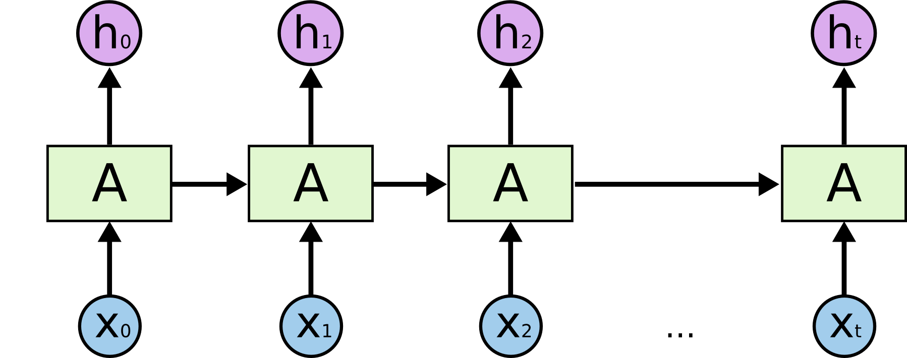
Simple RNN

Slide 12
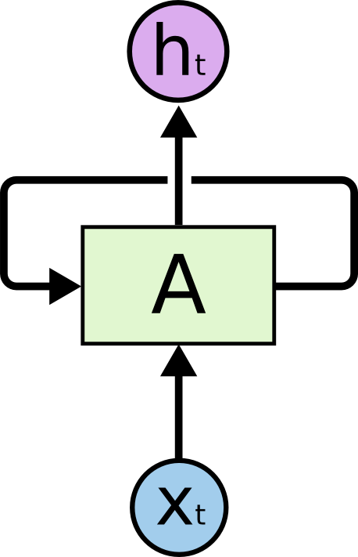
Simple RNN

Slide 13
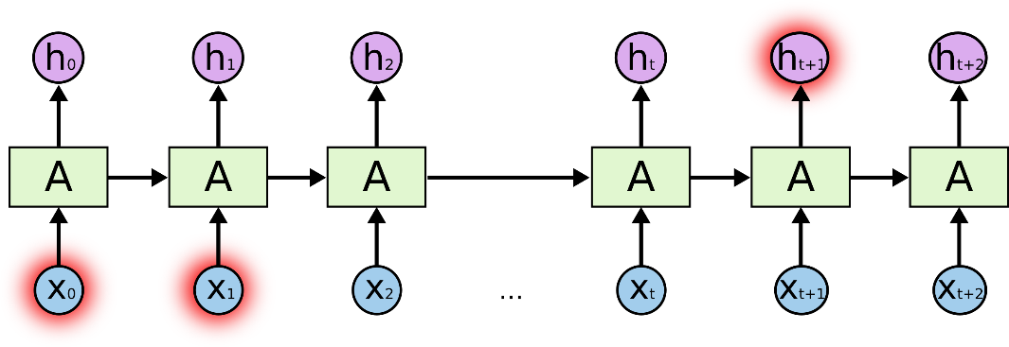
Drawbacks of simple RNN
Sometimes only recent information is enough to predict next word
“the clouds are in the (sky) ”
Sometimes not
“I grew up in France… I speak fluent (French) ”
To predict which language, we need the context of France, which could be far away from the current point
Unfortunately, as that gap grows, RNNs become unable to learn to connect the information.
Gradient vanishing problem

Slide 14

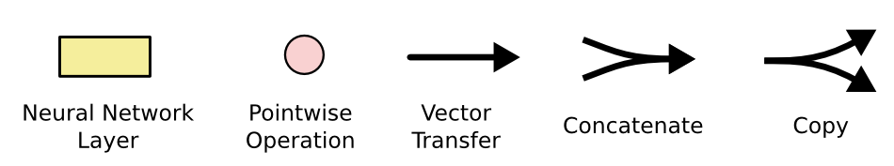
LSTM(Long Short Term Memory) network
A special kind of RNN
Introduced by Hochreiter & Schmidhuber (1997)
Maintains long-term memory by specially designed “cell state,” the horizontal line running through the top of the diagram
https://colah.github.io/posts/2015-08-Understanding-LSTMs/

Slide 15
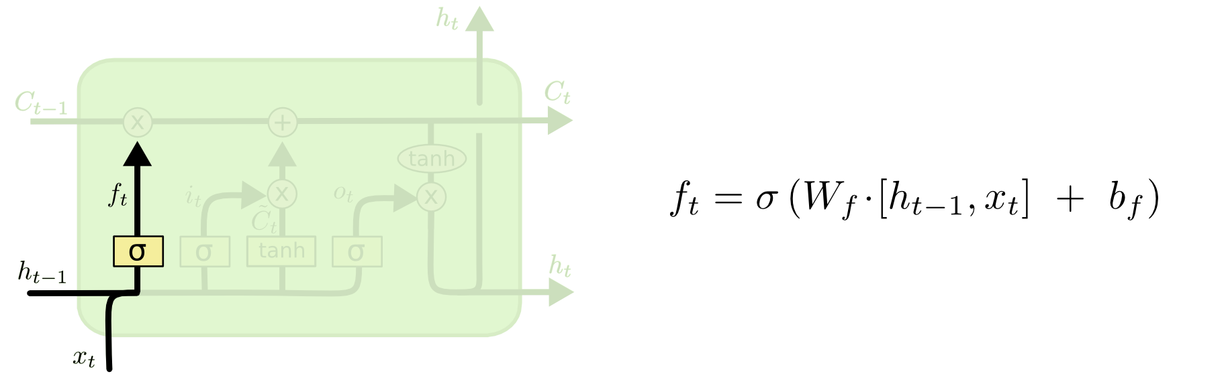

Slide 16
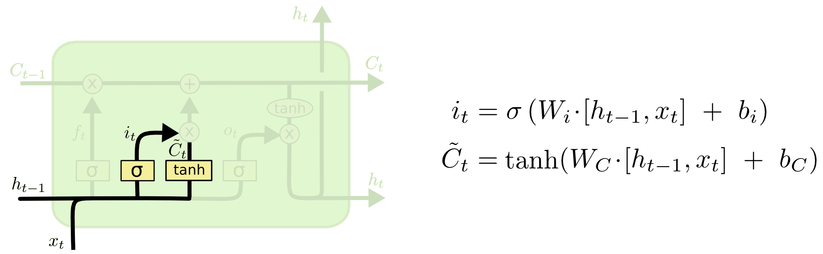

Slide 17
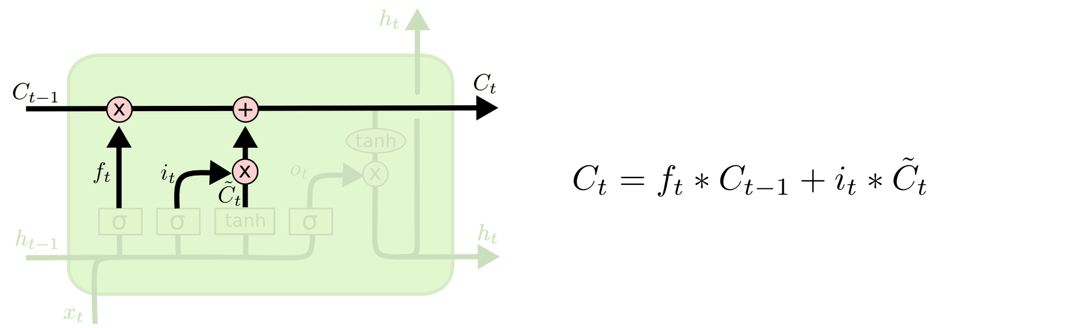

Slide 18
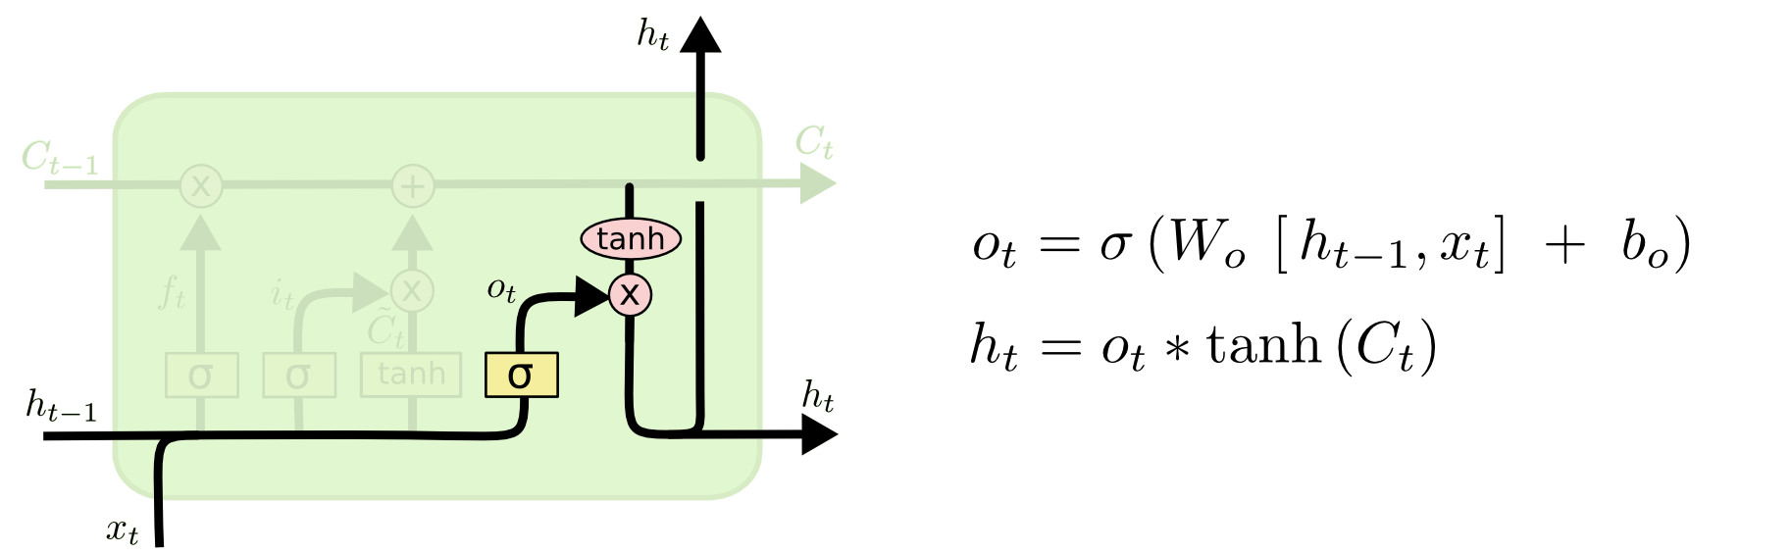

Slide 19
Let’s make a Sherlock-holmes style writer
ADVENTURE I. A SCANDAL IN BOHEMIA
To Sherlock Holmes she is always THE woman. I have seldom heard him mention her under any other name. In his eyes she eclipses and predominates the whole of her sex. It was not that he felt any emotion akin to love for Irene Adler. All emotions, and that one particularly, were abhorrent to his cold, precise but admirably balanced mind. He was, I take it, the most perfect reasoning and observing machine that the world has seen, but as a lover he would have placed himself in a false position. He never spoke of the softer passions, save with a gibe and a sneer. They were admirable things for the observer--excellent for drawing the veil from men's motives and actions. But for the trained reasoner to admit such intrusions into his own delicate and finely adjusted temperament was to introduce a distracting factor which might throw a doubt upon all his mental results. Grit in a sensitive instrument, or a crack in one of his own high-power lenses, would not be more disturbing than a strong emotion in a nature such as his. And yet there was but one woman to him, and that woman was the late Irene Adler, of dubious and questionable memory. …
By three approaches
Simple traditional NN
Simple RNN
LSTM
https://etc.usf.edu/lit2go/32/the-adventures-of-sherlock-holmes/345/adventure-1-a-scandal-in-bohemia/

